Slide 1
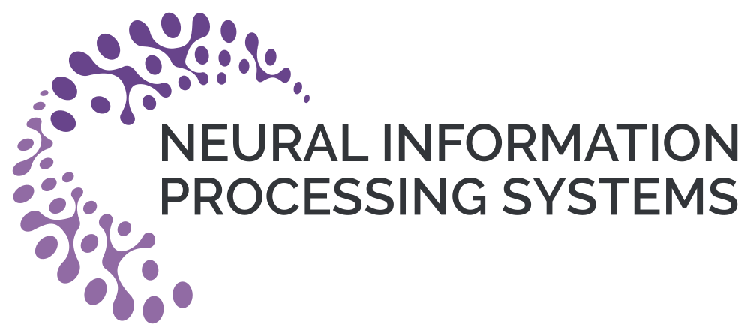



Interpretable Hybrid Neural-Cognitive Models Discover Cognitive Strategies Underlying Flexible Reversal Learning
Chonghao Cai*, Liyuan Li*, Yifei Cao*, Maria K. Eckstein‡

Slide 2
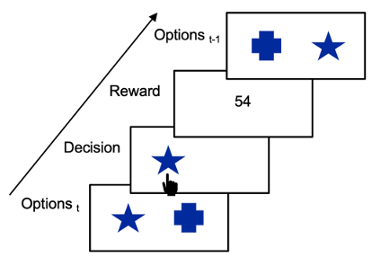
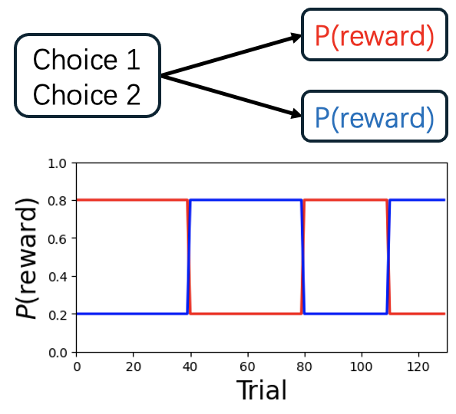
Research Background
Reversal learning behavior
Manual cognitive modeling using Rescorla Wagner Model
  Changing learning rate (Sidarus et al., 2019).
  Counterfactual learning rates and forgetting mechanism (Eckstein et al., 2022).
  Value reset around reversal (Barnby et al., 2022).
Automatic discovery using artificial neural network
  TinyRNN (Ji-An et al., 2025)
  DisRNN (Miller et al., 2023)
What about combining the both? (Eckstein et al., in press)
Notes:
Reversal learning task is a bandit task with sudden reward probability switching. It has been used a lot in cognitive psychology research for understanding the computation underlying flexible learning conditions.
For modeling the cognitive strategies, we can either manually build cognitive models by modifying the Rescorla wagner model, like having changing learning rate, adding value reset around reversal. These models are fully interpretable, but requires much handcrafting.
Thanks to powerful neural network technologies, we can also fit artificial neural network model to human behavior. However, lack of interpretability brings up the difficulty in understanding the cognitive strategy.
What would happen if we can combine the advantages of both methods?

Slide 3
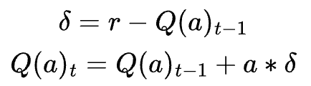
Classical Rescorla-Wagner Model
A_{t-1}
r_{t-1}
Q(a)_{t}
Q(a)_{t-1}
Notes:
In Rescorla wagner model, the subject value of chosen action is updated based on the reward and a learning rate alpha. This fixed learning rate is consistent across all conditions, therefore discarding a lot of dynamics in this learning process.

Slide 4
RL-ANN
A_{t-1}
r_{t-1}
Q(a)_{t-1}
Q(a)_{t-1}
R-W
Classical RL
Notes:
To capture more dynamics automatically, Maria raised the idea that we can replace this linear function with a MLP, and the MLP could act as an approximator to the real learning function. In this way, neural network is no more a black box but driven by strong cognitive hypothesis.

Slide 5
Context-ANN
A_{t-1}
r_{t-1}
Q(a)_{t}
Q(a)_{t-1}
Q(na)_{t-1}
R-W
Classical RL
RL-ANN
Notes:
Furthermore, the framework enable us to test more. For example, we can use subject value for the nonchosen action as additional input to test whether learning depends on contextual information. We call this model Context-ANN

Slide 6
Memory-ANN
A_{t-1}
r_{t-1}
Q(a)_{t}
Q(a)_{t-1}
S_{t-1}
R-W
a
na
Classical RL
RL-ANN
Context-ANN
Notes:
Also, we can extract the activation states from the hidden units and give it as input to the network to see whether the learning needs memory information. This model is called memory-ANN.

Slide 7
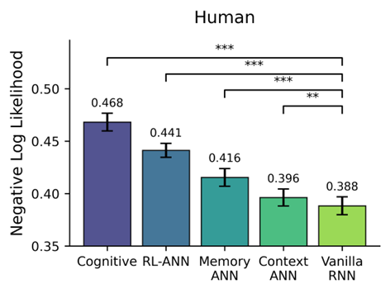
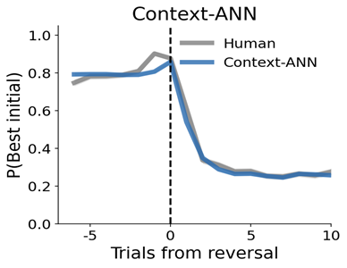


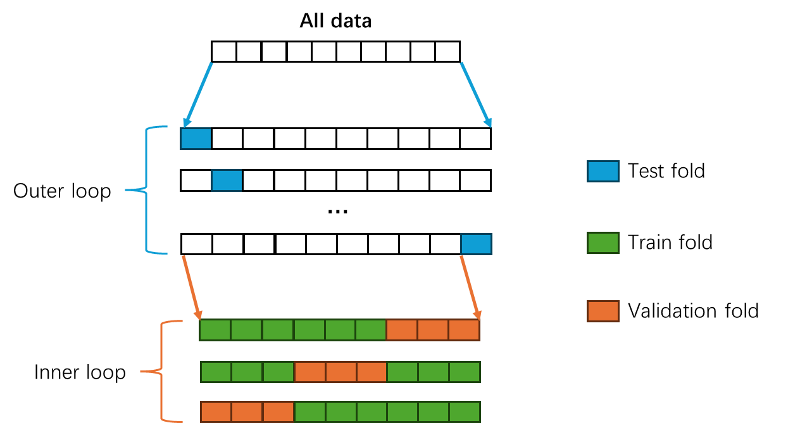
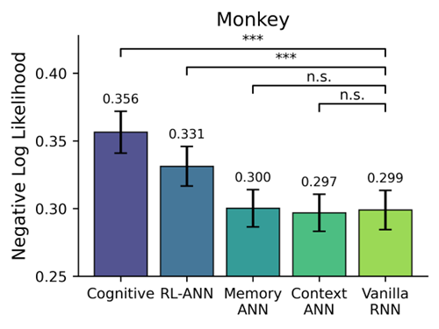
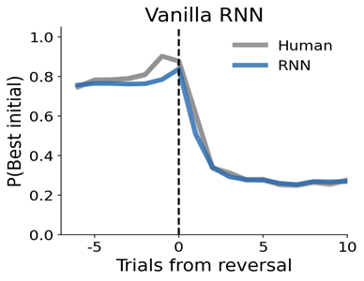
Context-ANN best captures reversal learning behavior
130 trials/session
699 sessions
80 trials/session
336 sessions
Nested Cross-Validation
Notes:
To quantitatively examine predictive power of each model, we merged several open access behavioral datasets into comprehensive human and monkey datasets, and followed a nested cross-validation process for model training and validation.
The results showed that context-ANN best captured behavior of both human and monkey, very close to the predictability of an uninterpretable RNN.
And we also qualitatively examined the behavioral patterns between models and found context-ANN has similar ability with RNN in capturing the behavioral dynamics of actual choices around reversal trials.
These results together showed that context information is important for modeling value updating function in reversal learning.
To quantitatively test and compare the predictive power of the models, we merged several open access behavior
So now that we have the model structure, we can ask: do these hybrid models actually predict behavior any better?
We tested all models on both the Human and Primate datasets, using negative log-likelihood as our main metric.
On the Human dataset, Context-ANN outperforms the other models and achieves near–RNN accuracy.
On the Monkey dataset, Context-ANN reaches performance that is statistically indistinguishable from the black-box vanilla RNN.
We also examined the behavioral dynamics. We align trials to the reversal point and plot the probability of staying with the previously best option. Context-ANN (blue) closely follows the human data (grey), capturing the sharp, rapid drop in stay probability right after the contingency switch. And its performance is comparable to the Vanilla-RNN.
Together, these results suggest that the model bridges the gap between interpretability and accuracy, and learns trial-by-trial adaptation strategies.

Slide 8
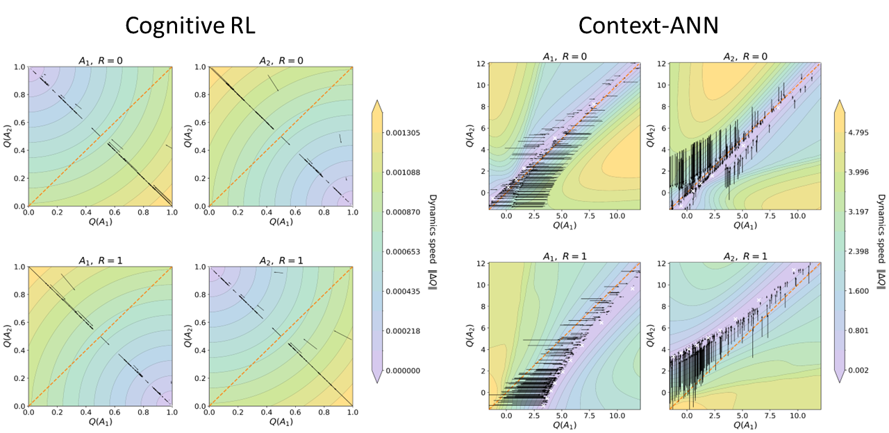
Flexible learning strategy in Context-ANN
Notes:
Since Context-ANN proved to be the best-fitting model, our next step was to open the ‘black box’ and understand its cognitive strategy. We did this by analyzing the network dynamics. By simulating the model across a range of initialized Q-values, we generated these vector fields. To guide you through the plot: the background color represents the velocity of change—darker regions indicate faster updates, while these zero-velocity zones form our attractor points. The black arrows overlaying the map track the actual Q-value trajectories during a single trial.
Now, comparing the two models reveals a striking difference in strategy. First, let's look at the case where the Reward is 0. Cognitive RL acts very greedily: it drives the chosen Q-value to 0, but aggressively pushes the unchosen Q-value all the way to 1. Context-ANN, however, is much more moderate. It tends to equilibrate, keeping the Q-values for both actions roughly equal. Essentially, it avoids forming a strong bias when there is no positive feedback. Even when the Reward is 1, we see a difference. While Context-ANN does shift its attractor toward the chosen action, it does not converge to the extreme greedy point like Cognitive RL does. It maintains a balanced representation.
So, why does this happen? We found that Context-ANN has learned a context-dependent update rule. It doesn't update the chosen action in isolation; it considers the belief state of the alternative action. If the other action's belief is low, a reward triggers a large update. But if the other action is already highly valued, the update is significantly dampened.
In conclusion, unlike the rigid linear rule in Cognitive RL, Context-ANN employs a complex, non-linear strategy. This allows for the flexible, context-sensitive learning that we observe in human cognition.

Slide 9
Conclusion
Hybrid cognitive-neural network model (HybridANN) captures human and monkey reversal learning behavior precisely.
By interpreting the network computation in HybridANN, we reveal the importance of context information and nonlinear value updating rule for reversal learning.
Future work would develop model to investigate the interaction between context and memory information together.

Slide 10
Thank you for listening!
Q&A

